Slide 1
Progress Presentation
By: Ben Warren, Jun Sik Kim

Slide 2
Background
CONTINUE HOUSING RESEARCH FROM MINI-PROJECTS
DIVE DEEPER INTO IMPACT OF ENVIRONMENTAL AND NEIGHBORHOOD FACTORS
research PLACES WE WANT TO LIVE after graduation

Slide 3
Research Question(s)
To what extent do the environmental factors of a neighborhood affect housing prices?
Does the characteristics of a house or environmental factors have more influence on housing prices?
Which environmental factors are most predictive of home prices?
Which environmental factors under/over value home prices?

Slide 4





Data Sources

Slide 5
Data Processing
Detroit Data
Philly Data
Chicago Data
Conn. Data
Pittsburgh Data
~6 million rows
1.7 million rows
Filtering

Slide 6
Exploratory Data Analysis

Slide 7
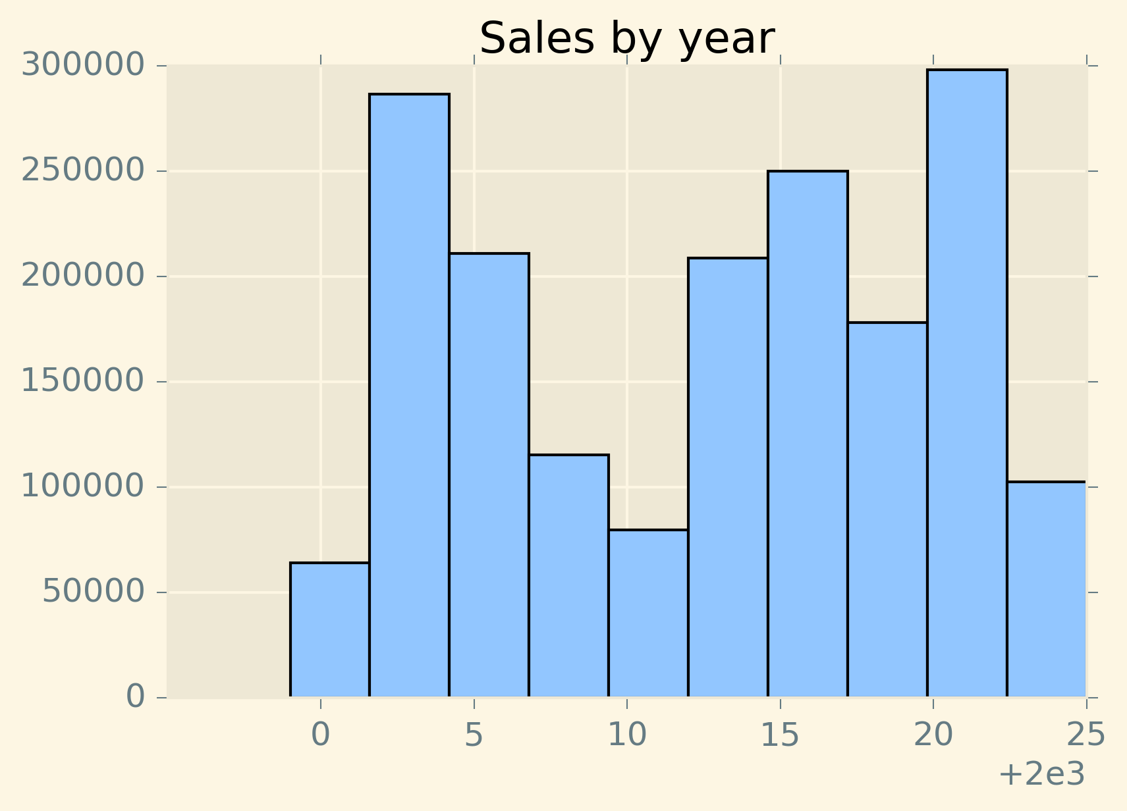

Slide 8
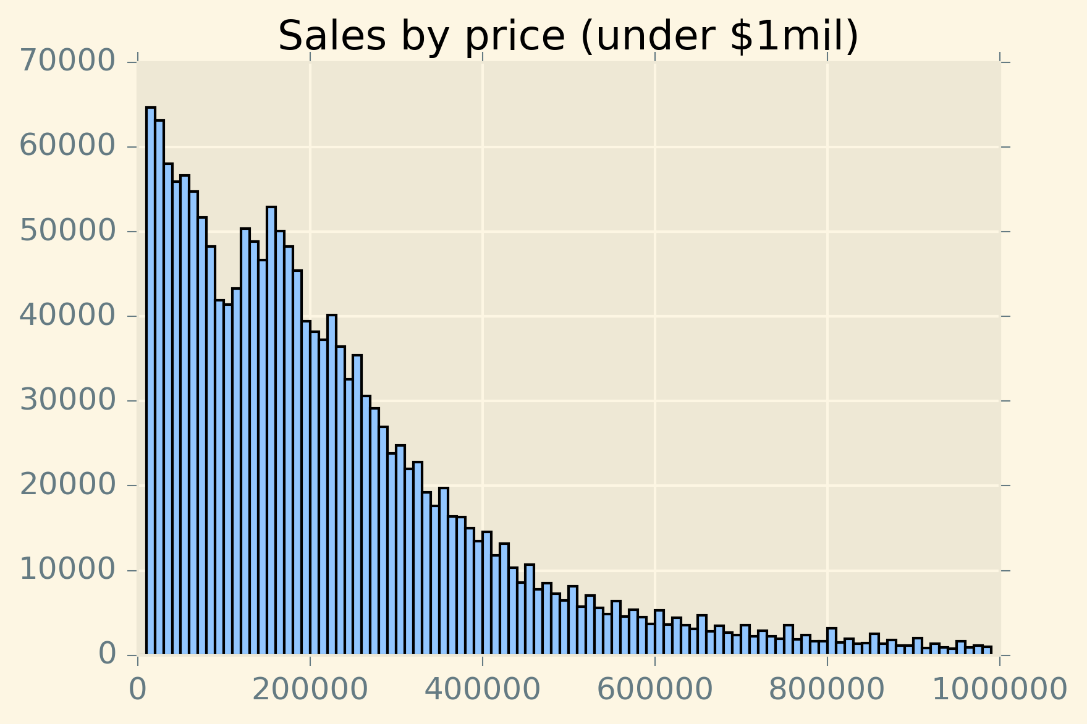

Slide 9
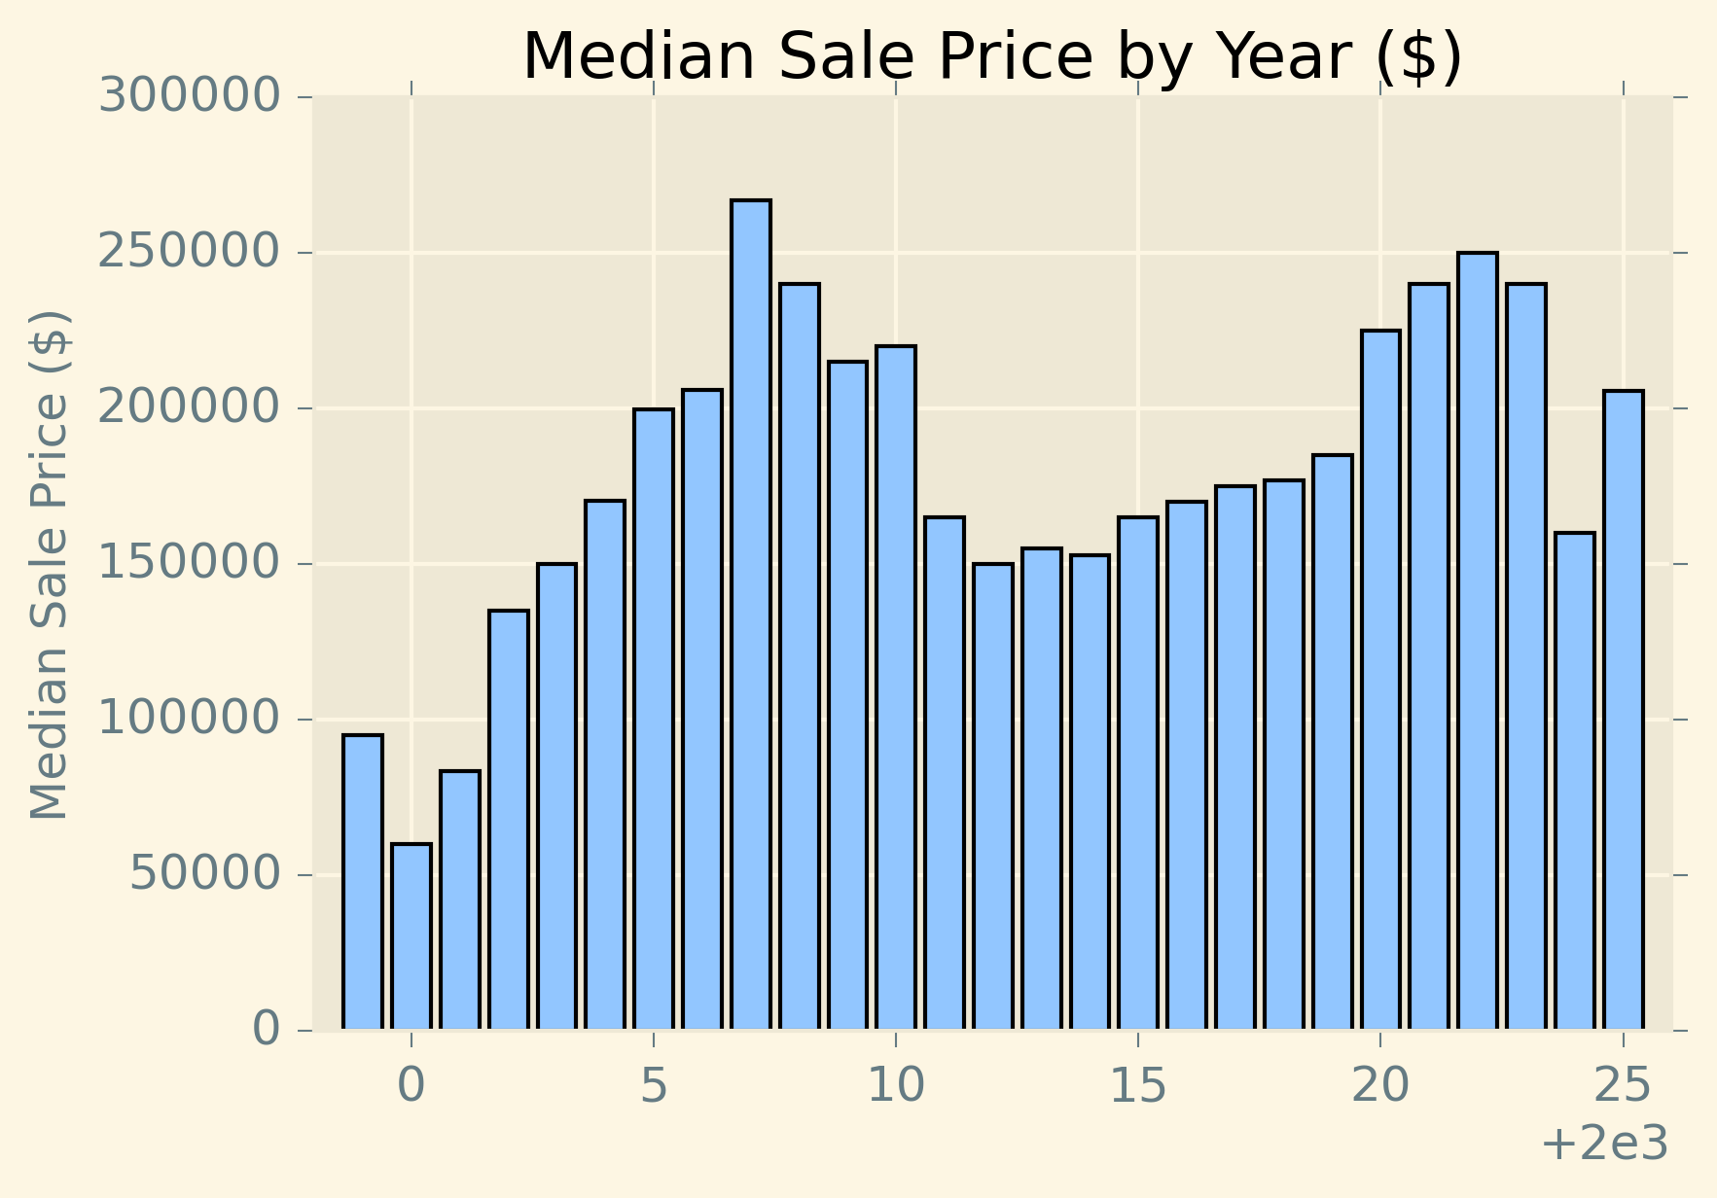

Slide 10
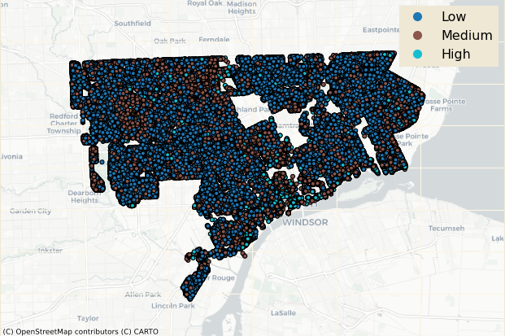
Detroit home sales by price

Slide 11
Potential models
Baseline : linear regression model
Random forest model
Convolutional Neural Networks
Geographically Weighted Regression
Notes:
Linear regression model
Might be overfitted with the number of variables that we want to look at but will provide a baseline for analysis
Random forest model
Helps to overcome the overfitting problem through creating multiple decision trees and then choosing the best one
Convolutional Neural Networks
Specialized for processing image data – when we want to use the GIS data
Geographically weighted regression
Estimates separate coefficient based on nearby data points
Allows the variables to have different coefficient based on their geographical location

